Slide 1
Relational Database Design
Dr. M. Brindha
Assistant Professor
Department of CSE
NIT, Trichy-15

Slide 2
First Normal Form
Domain is atomic if its elements are considered to be indivisible units
Examples of non-atomic domains:
Set of names, composite attributes
Identification numbers like CS101 that can be broken up into parts
A relational schema R is in first normal form if the domains of all attributes of R are atomic
Non-atomic values complicate storage and encourage redundant (repeated) storage of data
E.g. Set of accounts stored with each customer, and set of owners stored with each account

Slide 3
First Normal Form (Contd.)
Atomicity is actually a property of how the elements of the domain are used.
E.g. Strings would normally be considered indivisible
Suppose that students are given roll numbers which are strings of the form CS0012 or EE1127
If the first two characters are extracted to find the department, the domain of roll numbers is not atomic.
Doing so is a bad idea: leads to encoding of information in application program rather than in the database.

Slide 4
Pitfalls in Relational Database Design
Relational database design requires that we find a “good” collection of relation schemas. A bad design may lead to
Repetition of Information.
Inability to represent certain information.
Design Goals:
Avoid redundant data
Ensure that relationships among attributes are represented
Facilitate the checking of updates for violation of database integrity constraints.

Slide 5
First Normal Form
Disallows
composite attributes
multivalued attributes
nested relations; attributes whose values for an individual tuple are non-atomic
Considered to be part of the definition of relation

Slide 6
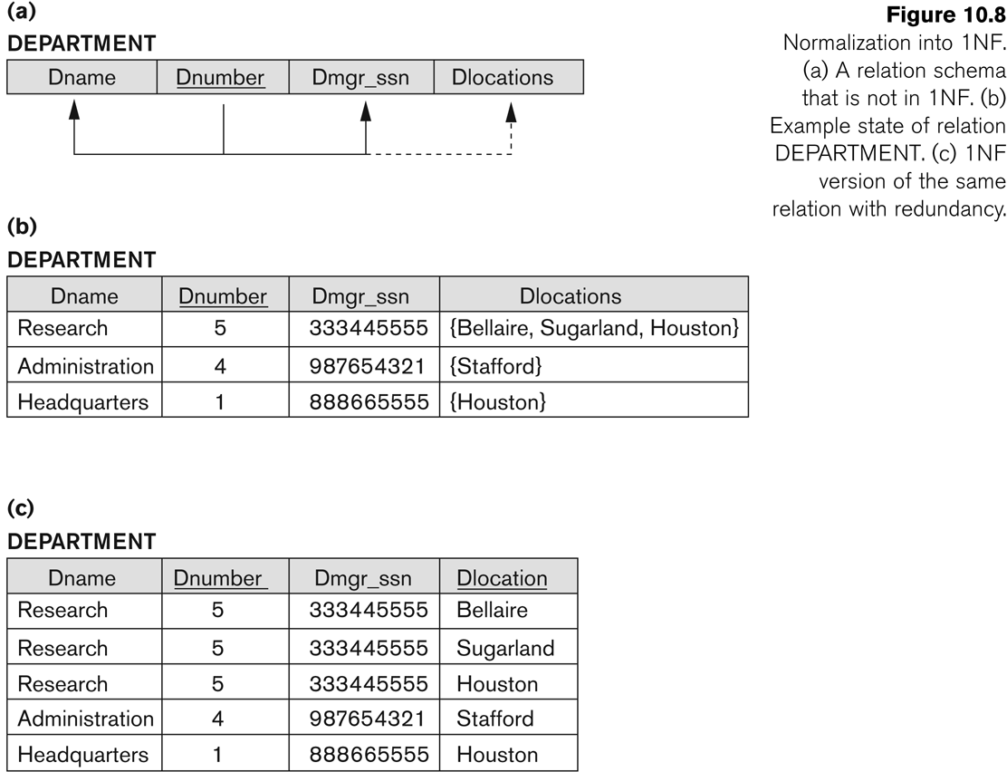
Normalization into 1NF

Slide 7
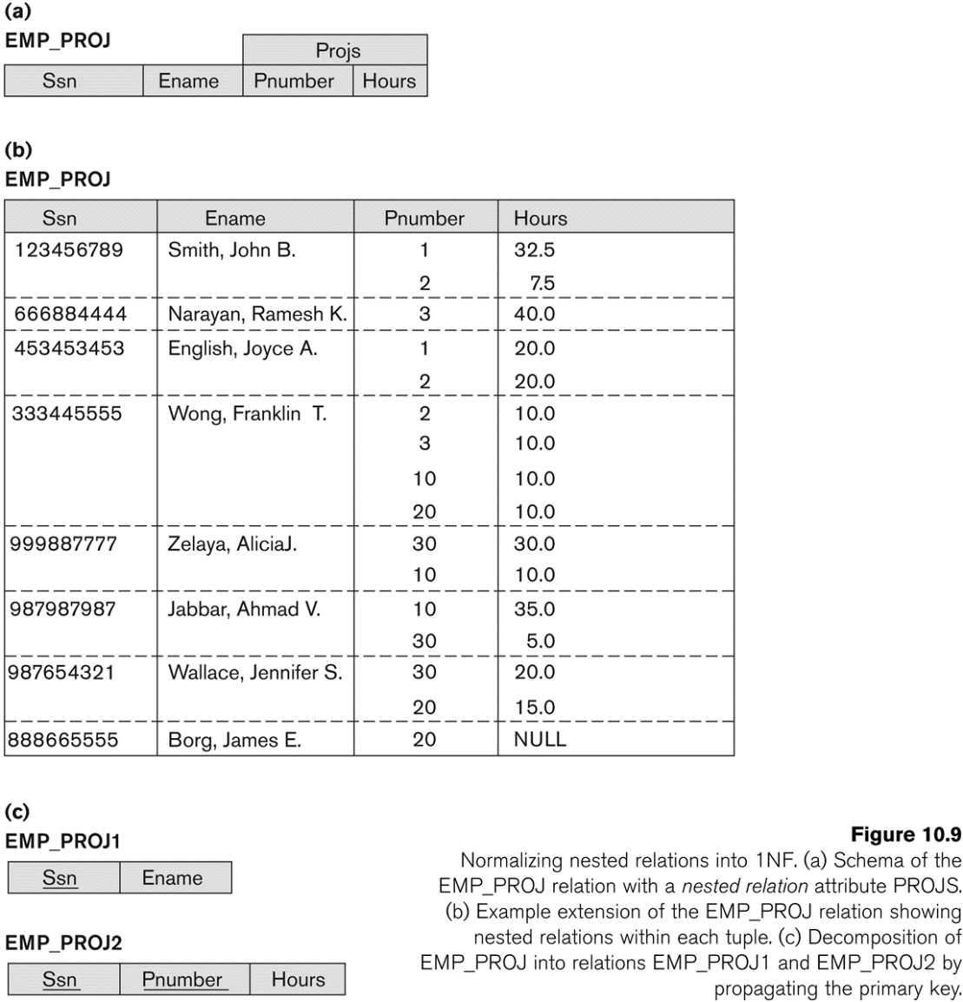
Normalization nested relations into 1NF

Slide 8
Pitfalls in Relational Database Design
Relational database design requires that we find a “good” collection of relation schemas. A bad design may lead to
Repetition of Information.
Inability to represent certain information.
Design Goals:
Avoid redundant data
Ensure that relationships among attributes are represented
Facilitate the checking of updates for violation of database integrity constraints.

Slide 9
Goals of Normalization
Decide whether a particular relation R is in “good” form.
In the case that a relation R is not in “good” form, decompose it into a set of relations {R₁, R₂, ..., R_{n}} such that
each relation is in good form
the decomposition is a lossless-join decomposition
Our theory is based on:
functional dependencies
multivalued dependencies

Slide 10
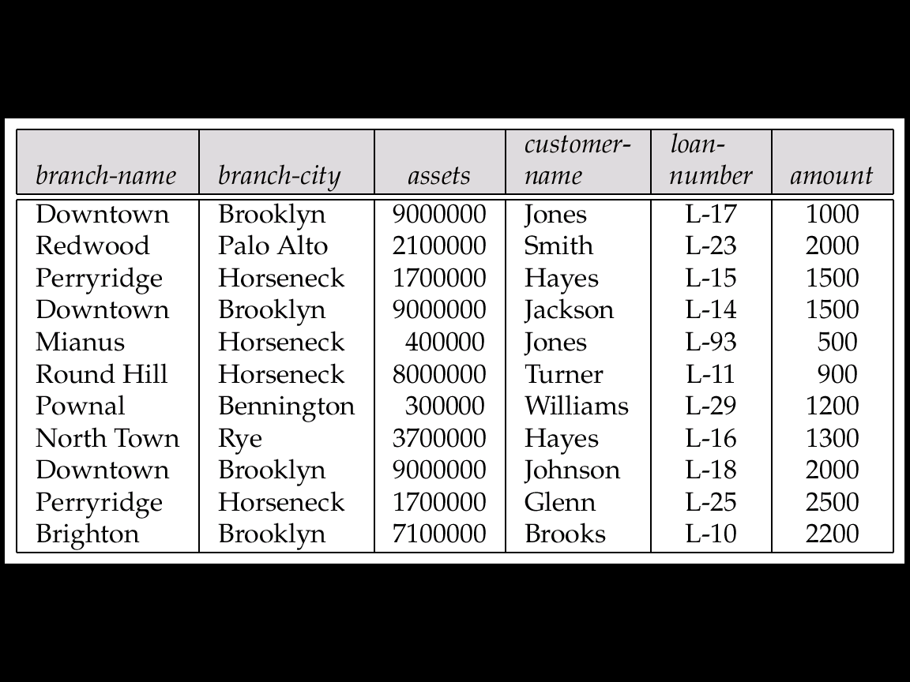
Example
Consider the relation schema: Lending-schema = (branch-name, branch-city, assets, customer-name, loan-number, amount)
Redundancy:
Data for branch-name, branch-city, assets are repeated for each loan that a branch makes
Wastes space
Complicates updating, introducing possibility of inconsistency of assets value
Null values
Cannot store information about a branch if no loans exist
Can use null values, but they are difficult to handle.

Slide 11
Redundant Information in Tuples and Update Anomalies
Information is stored redundantly
Wastes storage
Causes problems with update anomalies
Insertion anomalies
Deletion anomalies
Modification anomalies

Slide 12
EXAMPLE OF AN UPDATE ANOMALY
Consider the relation:
Lending-schema = (branch-name, branch-city, assets, customer-name, loan-number, amount)
Update Anomaly:
Changing the assets from “1900000” to “1700000” may cause this update to be made for all customers on corresponding branch

Slide 13
EXAMPLE OF AN INSERT ANOMALY
Consider the relation:
Lending-schema = (branch-name, branch-city, assets, customer-name, loan-number, amount)
Insert Anomaly:
Cannot insert values if branch does not have any loan.

Slide 14
EXAMPLE OF AN DELETE ANOMALY
Consider the relation:
Lending-schema = (branch-name, branch-city, assets, customer-name, loan-number, amount)
Delete Anomaly:
When a branch is deleted, it will result in deleting all the loans on that branch.
Alternately, if a branch has a single loan, deleting that laon would result in deleting the corresponding branch.

Slide 15
Null Values in Tuples
GUIDELINE 3:
Relations should be designed such that their tuples will have as few NULL values as possible
Attributes that are NULL frequently could be placed in separate relations (with the primary key)
Reasons for nulls:
Attribute not applicable or invalid
Attribute value unknown (may exist)
Value known to exist, but unavailable

Slide 16
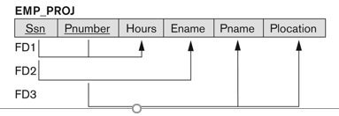
Relation schema suffering from update anomaly

Slide 17
EXAMPLE OF AN UPDATE ANOMALY
Consider the relation:
EMP_PROJ(Emp#, Proj#, Ename, Pname, No_hours)
Update Anomaly:
Changing the name of project number P1 from “Billing” to “Customer-Accounting” may cause this update to be made for all 100 employees working on project P1.

Slide 18
Decomposition
Decompose the relation schema Lending-schema into:
Branch-schema = (branch-name, branch-city,assets)
Loan-info-schema = (customer-name, loan-number, branch-name, amount)
All attributes of an original schema (R) must appear in the decomposition (R₁, R₂):
R = R₁ ∪ R₂
Lossless-join decomposition. For all possible relations r on schema R
r = ∏_{R1} (r) ∏_{R2} (r)

Slide 19
Example of Non Lossless-Join Decomposition
Decomposition of R = (A, B) R₁ = (A) R₂ = (B)
A
B
A
B
α
α
β
1
2
1
α
β
1
2
∏_{A}(r)
∏_{B(r)}
r
∏_{A} (r) ∏_{B} (r)
A
B
α
α
β
β
1
2
1
2

Slide 20
The Relation Lending(11 tuples)
Lossless join decomposition
Lending-schema = (branch-name, branch-city, assets, customer-name, loan-number, amount)

Slide 21
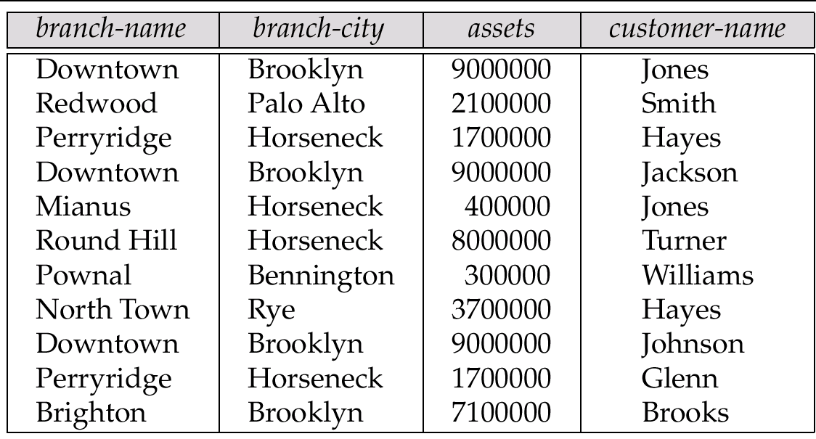
The Relation branch-customer(11 tuples)
Lossless join decomposition

Slide 22
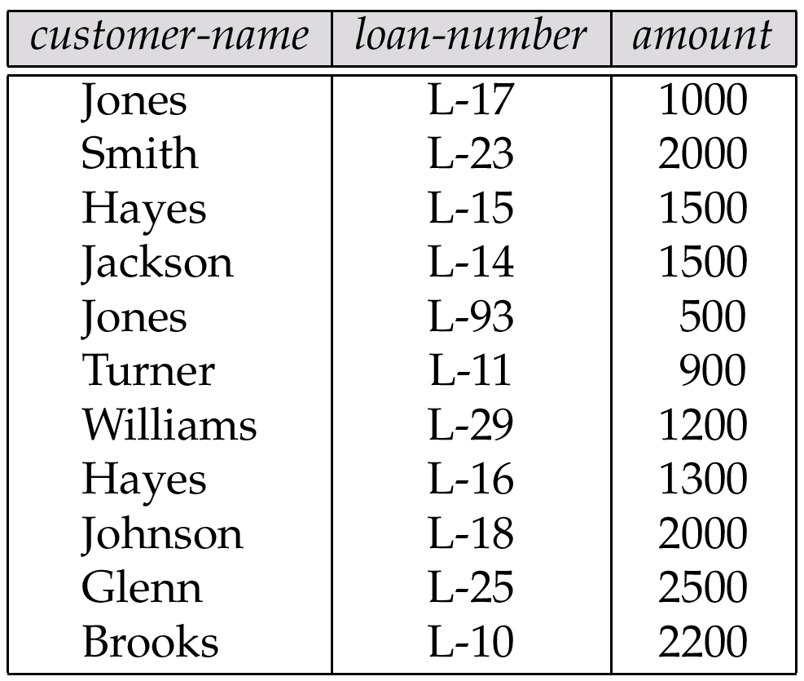
The Relation customer-loan (11 tuples)

Slide 23
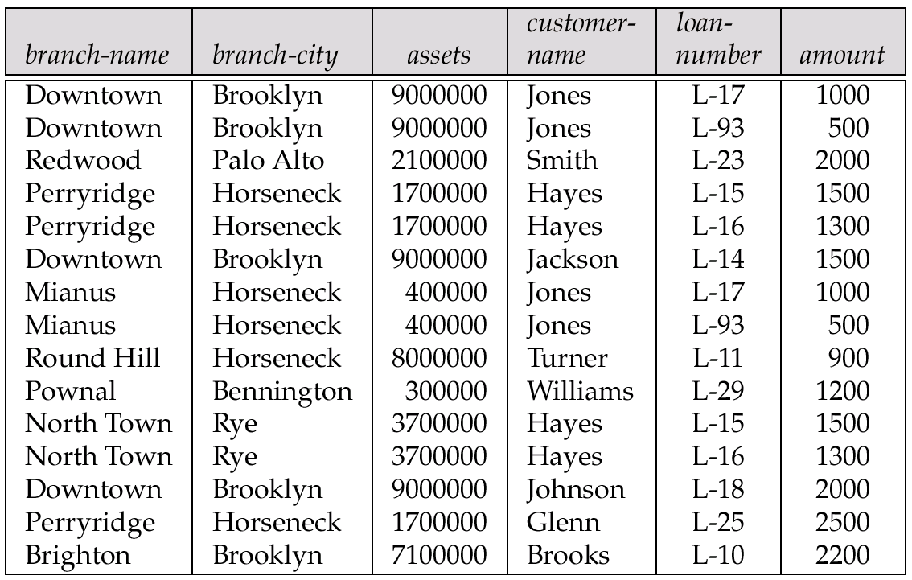
The Relation branch-customer customer-loan (15 tuples)
Inference:
1. Additional 4 tuples
2. Find all branches with loan amount<1000, From lending schema it is Mianus and Roundhill and for Joined schema it is Mianus, Roundhill and Downtown.

Slide 24
Spurious Tuples or Dangling Tuples
Bad designs for a relational database may result in erroneous results for certain JOIN operations
The "lossless join" property is used to guarantee meaningful results for join operations
GUIDELINE 4:
The relations should be designed to satisfy the lossless join condition.
No spurious tuples should be generated by doing a natural-join of any relations.

Slide 25
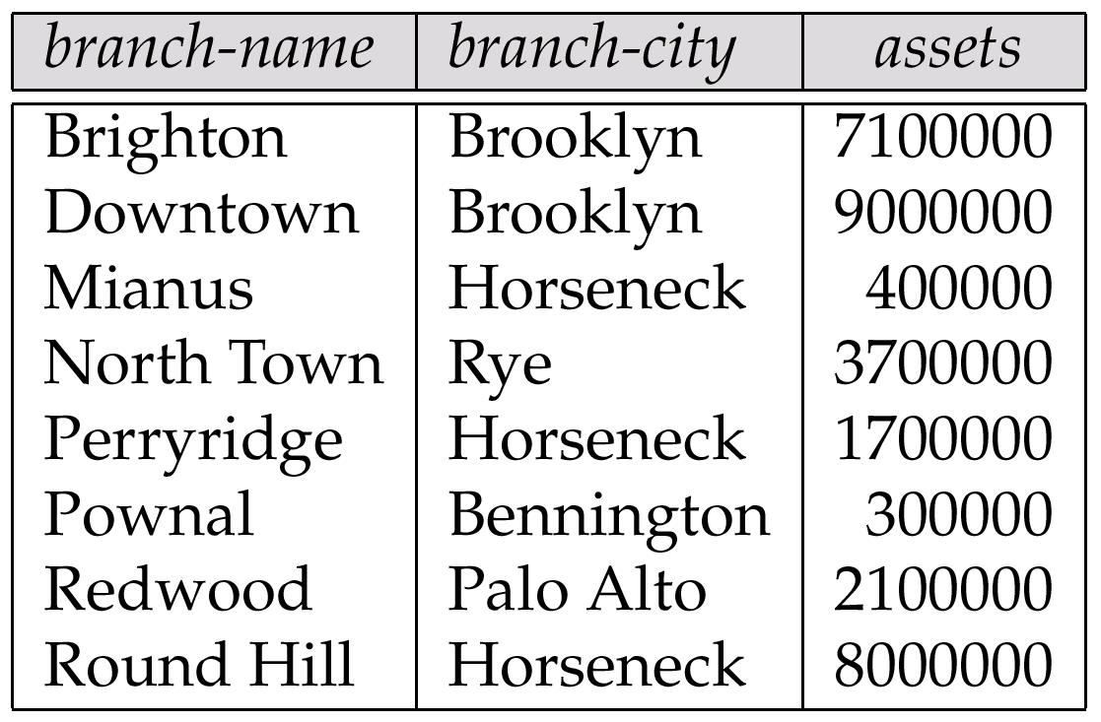
The branch Relation

Slide 26
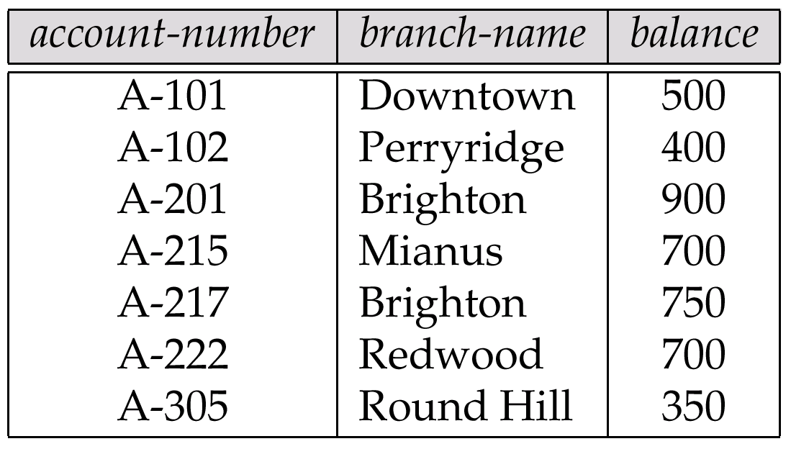
Account Relation
A-405 | Carolina | 700

Slide 27

Goal — Devise a Theory for the Following
Decide whether a particular relation R is in “good” form.
In the case that a relation R is not in “good” form, decompose it into a set of relations {R₁, R₂, ..., R_{n}} such that
each relation is in good form
the decomposition is a lossless-join decomposition
Our theory is based on:
functional dependencies
multivalued dependencies

Slide 28
Functional Dependencies
Constraints on the set of legal relations.
Require that the value for a certain set of attributes determines uniquely the value for another set of attributes.
A functional dependency is a generalization of the notion of a key.

Slide 29
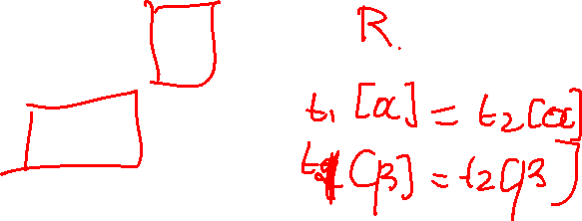
Functional Dependencies (Cont.)
Let R be a relation schema
α ⊆ R and β ⊆ R
The functional dependency
α → β
holds on R if and only if for any legal relations r(R), whenever any two tuples t₁ and t₂ of r agree on the attributes α, they also agree on the attributes β. That is,
t₁[α] = t₂ [α] ⇒ t₁[β ] = t₂ [β ]

Slide 30
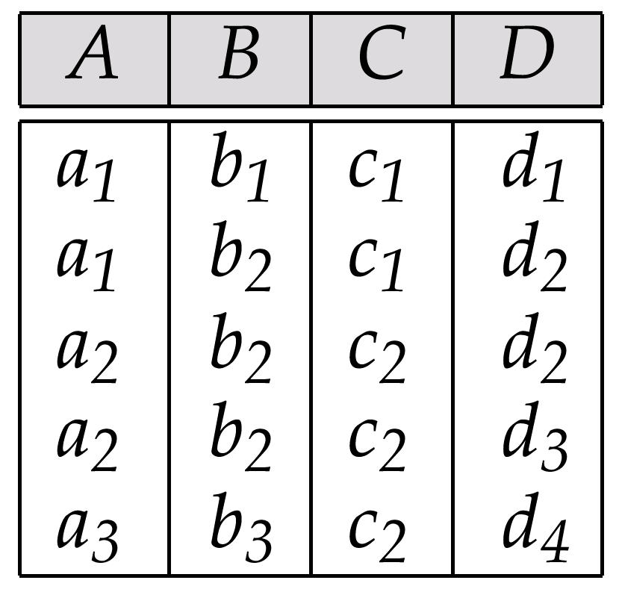
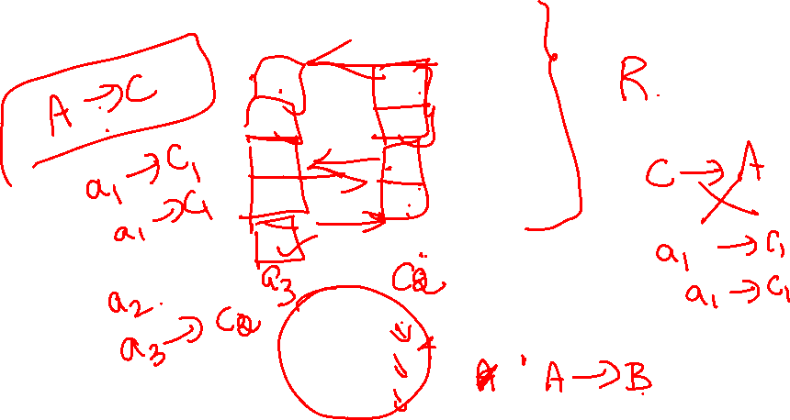
Functional Dependencies (Cont.)
Example: Consider r(A,B) with the following instance of r.
On this instance, A → B does NOT hold, but B → A does hold.
4
1 5
3 7

Slide 31
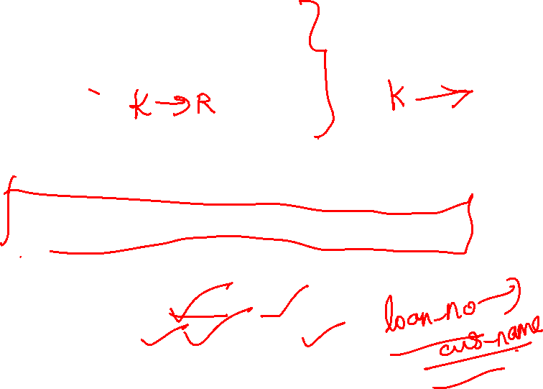
Functional Dependencies (Cont.)
K is a superkey for relation schema R if and only if K → R
K is a candidate key for R if and only if
K → R, and
for no α ⊂ K, α → R
Functional dependencies allow us to express constraints that cannot be expressed using superkeys. Consider the schema:
Loan-info-schema = (customer-name, loan-number, branch-name, amount).
We expect this set of functional dependencies to hold:
loan-number → amount loan-number → branch-name
but would not expect the following to hold:
loan-number → customer-name

Slide 32
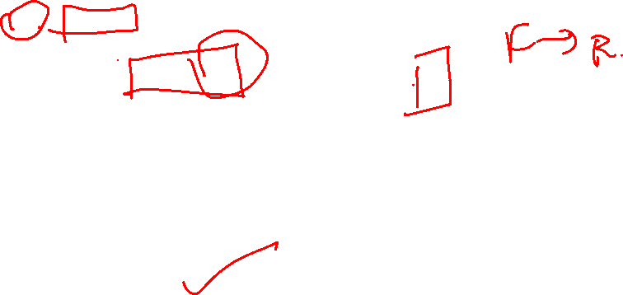
Use of Functional Dependencies
We use functional dependencies to:
test relations to see if they are legal under a given set of functional dependencies.
If a relation r is legal under a set F of functional dependencies, we say that r satisfies F.
specify constraints on the set of legal relations
We say that F holds on R if all legal relations on R satisfy the set of functional dependencies F.
Note: A specific instance of a relation schema may satisfy a functional dependency even if the functional dependency does not hold on all legal instances.
For example, a specific instance of Loan-schema may, by chance, satisfy loan-number → customer-name.

Slide 33
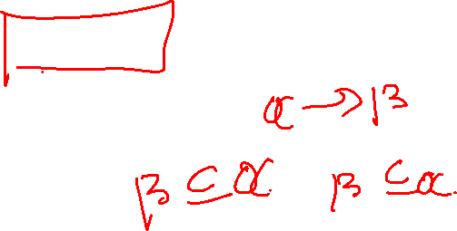
Functional Dependencies (Cont.)
A functional dependency is trivial if it is satisfied by all instances of a relation
E.g.
customer-name, loan-number → customer-name
customer-name → customer-name
In general, α → β is trivial if β ⊆ α

Slide 34
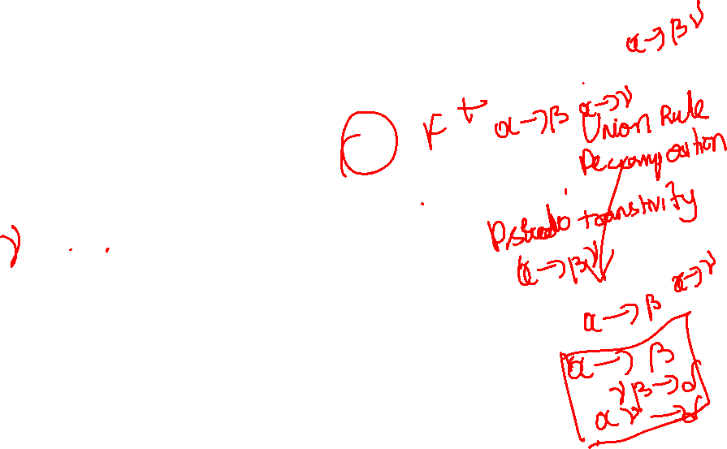

Closure of a Set of Functional Dependencies
Given a set F set of functional dependencies, there are certain other functional dependencies that are logically implied by F.
E.g. If A → B and B → C, then we can infer that A → C
The set of all functional dependencies logically implied by F is the closure of F.
We denote the closure of F by F⁺.
We can find all of F⁺ by applying Armstrong’s Axioms:
if β ⊆ α, then α → β (reflexivity)
if α → β, then γ α → γ β (augmentation)
if α → β, and β → γ, then α → γ (transitivity)
These rules are
sound (generate only functional dependencies that actually hold) and
complete (generate all functional dependencies that hold).

Slide 35
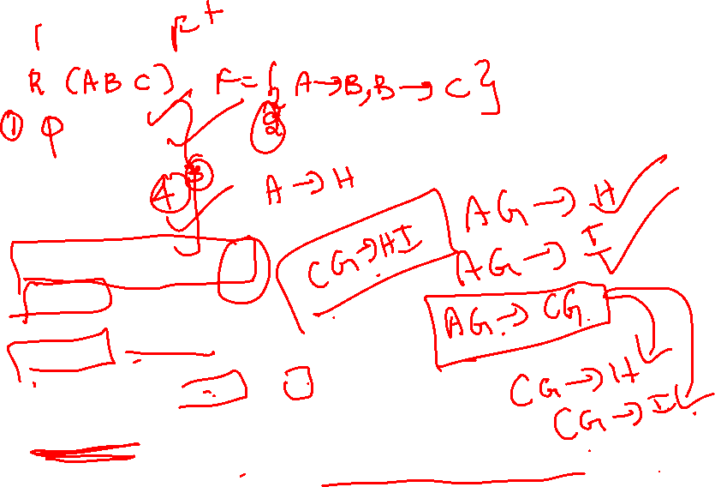
Example
R = (A, B, C, G, H, I) F = { A → B A → C CG → H CG → I B → H}
some members of F⁺
A → H
by transitivity from A → B and B → H
AG → I
by augmenting A → C with G, to get AG → CG and then transitivity with CG → I
CG → HI
from CG → H and CG → I : “union rule” can be inferred from
definition of functional dependencies, or
Augmentation of CG → I to infer CG → CGI, augmentation of CG → H to infer CGI → HI, and then transitivity

Slide 36

Procedure for Computing F⁺
To compute the closure of a set of functional dependencies F:
F⁺ = F repeat for each functional dependency f in F⁺ apply reflexivity and augmentation rules on f add the resulting functional dependencies to F⁺ for each pair of functional dependencies f₁and f₂ in F⁺ if f₁ and f₂ can be combined using transitivity then add the resulting functional dependency to F⁺ until F⁺ does not change any further

Slide 37
Closure of Functional Dependencies (Cont.)
We can further simplify manual computation of F⁺ by using the following additional rules.
If α → β holds and α → γ holds, then α → β γ holds (union)
If α → β γ holds, then α → β holds and α → γ holds (decomposition)
If α → β holds and γ β → δ holds, then α γ → δ holds (pseudotransitivity)
The above rules can be inferred from Armstrong’s axioms.

Slide 38
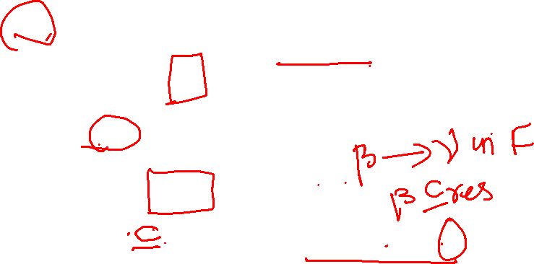
Closure of Attribute Sets
Given a set of attributes α, define the closure of α under F (denoted by α⁺) as the set of attributes that are functionally determined by α under F: α → β is in F⁺ ⬄ β ⊆ α⁺
Algorithm to compute α⁺, the closure of α under F result := α; while (changes to result) do for each β → γ in F do begin if β ⊆ result then result := result ∪ γ end

Slide 39
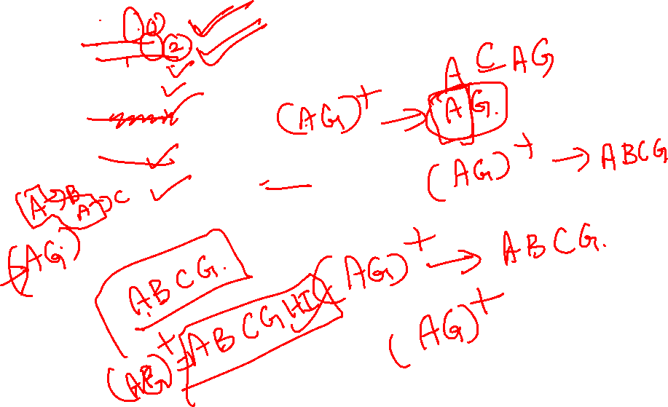

Example of Attribute Set Closure
R = (A, B, C, G, H, I)
F = {A → B A → C CG → H CG → I B → H}
(AG)⁺
1. result = AG
2. result = ABCG (A → C and A → B)
3. result = ABCGH (CG → H and CG ⊆ AGBC)
4. result = ABCGHI (CG → I and CG ⊆ AGBCH)
Is AG a candidate key?
Is AG a super key?
Does AG → R? == Is (AG)⁺ ⊇ R
Is any subset of AG a superkey?
Does A → R? == Is (A)⁺ ⊇ R
Does G → R? == Is (G)⁺ ⊇ R

Slide 40

Uses of Attribute Closure
There are several uses of the attribute closure algorithm:
Testing for superkey:
To test if α is a superkey, we compute α^{+,} and check if α⁺ contains all attributes of R.
Testing functional dependencies
To check if a functional dependency α → β holds (or, in other words, is in F⁺), just check if β ⊆ α⁺.
That is, we compute α⁺ by using attribute closure, and then check if it contains β.
Is a simple and cheap test, and very useful
Computing closure of F
For each γ ⊆ R, we find the closure γ⁺, and for each S ⊆ γ⁺, we output a functional dependency γ → S.

Slide 41
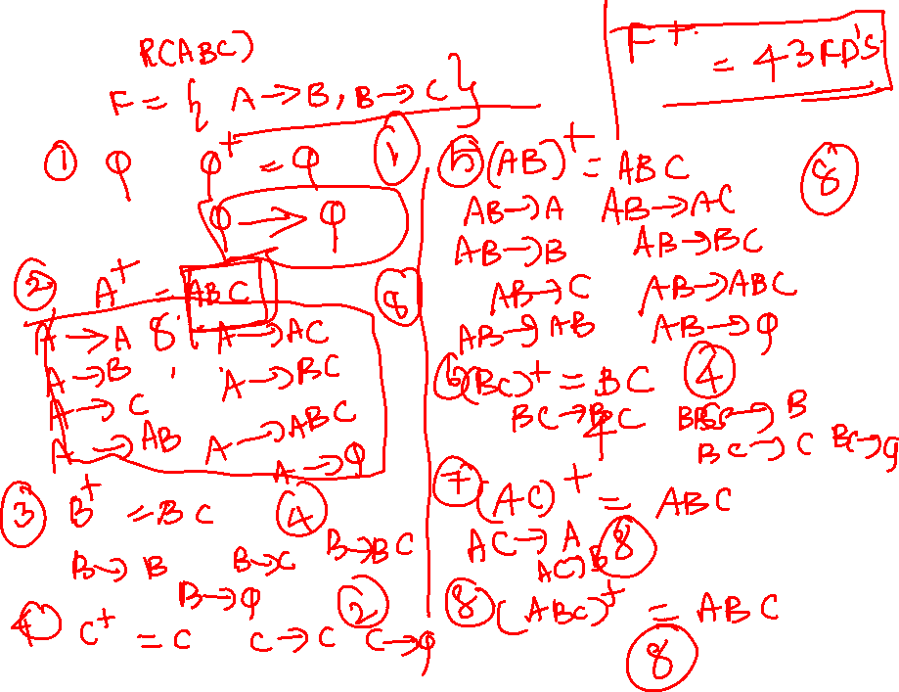

Slide 42
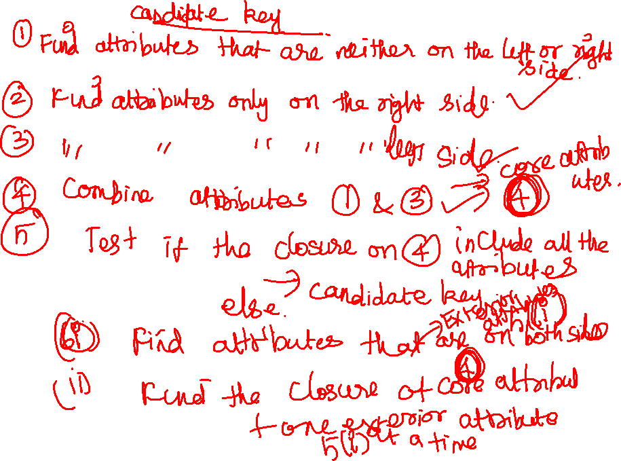

Slide 43
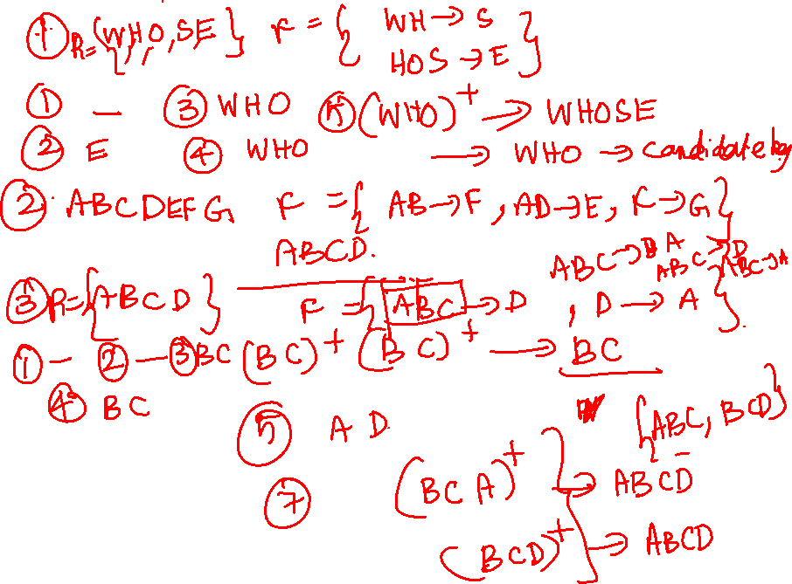

Slide 44
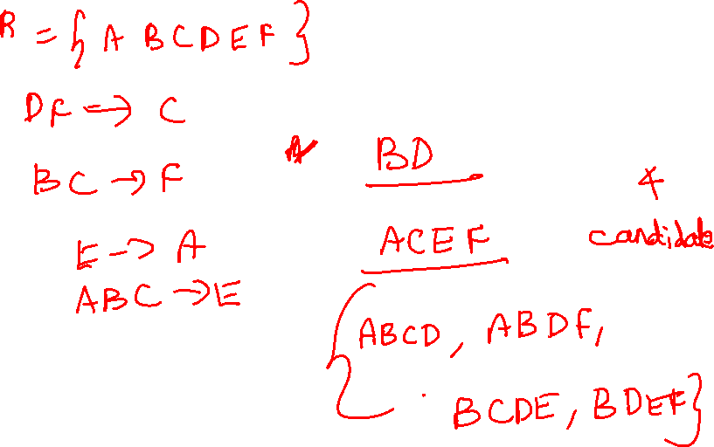

Slide 45
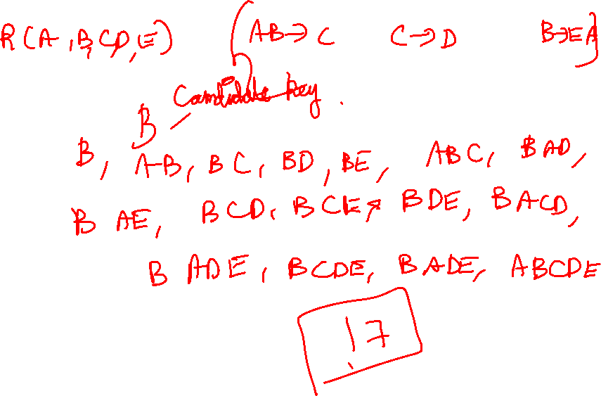

Slide 46
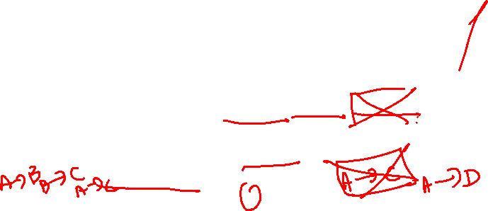
Canonical Cover
Sets of functional dependencies may have redundant dependencies that can be inferred from the others
Eg: A → C is redundant in: {A → B, B → C, A → C}
Parts of a functional dependency may be redundant
E.g. on RHS: {A → B, B → C, A → CD} can be simplified to {A → B, B → C, A → D}
E.g. on LHS: {A → B, B → C, AC → D} can be simplified to {A → B, B → C, A → D}
Intuitively, a canonical cover of F is a “minimal” set of functional dependencies equivalent to F, having no redundant dependencies or redundant parts of dependencies

Slide 47
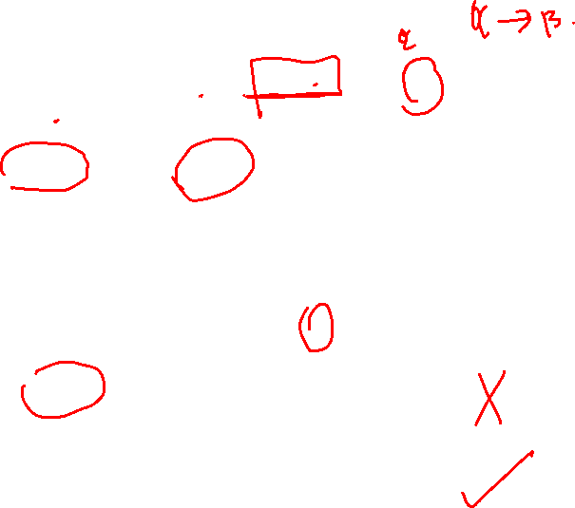
Extraneous Attributes
Consider a set F of functional dependencies and the functional dependency α → β in F.
Attribute A is extraneous in α if A ∈ α and F logically implies (F – {α → β}) ∪ {(α – A) → β}.
Attribute A is extraneous in β if A ∈ β and the set of functional dependencies (F – {α → β}) ∪ {α →(β – A)} logically implies F.
Note: implication in the opposite direction is trivial in each of the cases above, since a “stronger” functional dependency always implies a weaker one
Example: Given F = {A → C, AB → C }
B is extraneous in AB → C because {A → C, AB → C} logically implies A → C (I.e. the result of dropping B from AB → C).
Example: Given F = {A → C, AB → CD}
C is extraneous in AB → CD since AB → C can be inferred even after deleting C

Slide 48
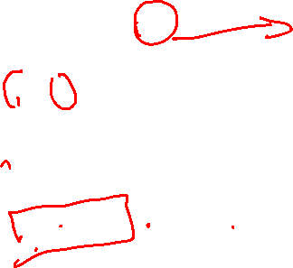
Testing if an Attribute is Extraneous
Consider a set F of functional dependencies and the functional dependency α → β in F.
To test if attribute A ∈ α is extraneous in α
compute ({α} – A)⁺ using the dependencies in F
check that ({α} – A)⁺ contains A; if it does, A is extraneous
To test if attribute A ∈ β is extraneous in β
compute α⁺ using only the dependencies in F’ = (F – {α → β}) ∪ {α →(β – A)},
check that α⁺ contains A; if it does, A is extraneous

Slide 49
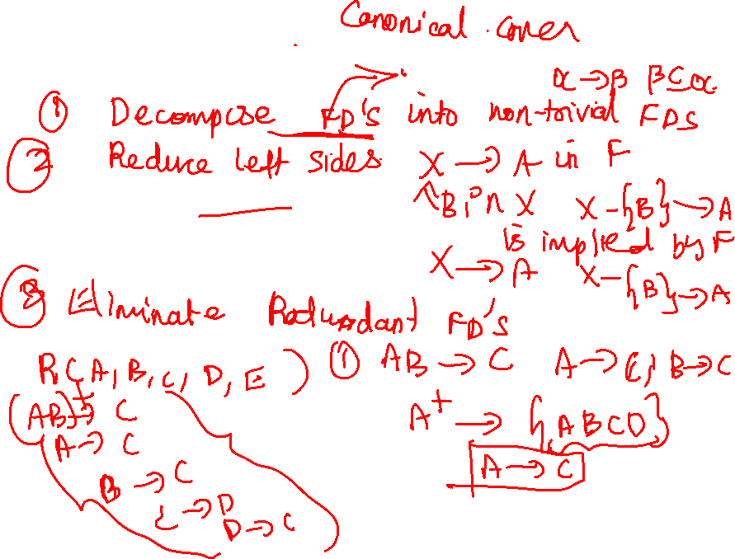
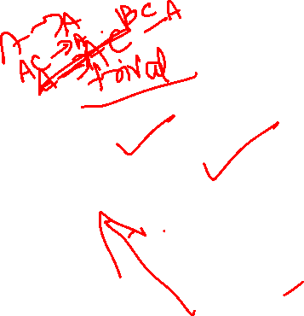

Slide 50
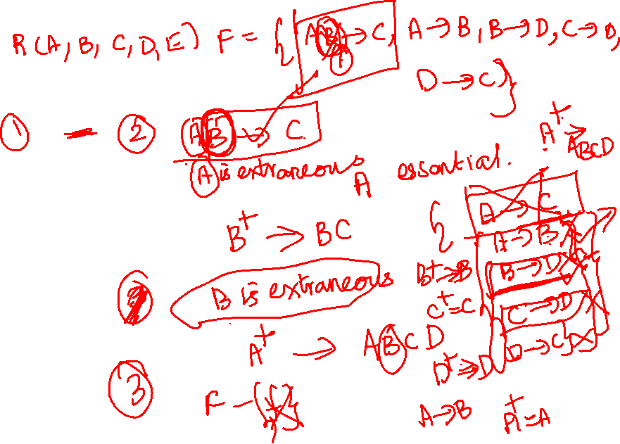
Canonical Cover
A canonical cover for F is a set of dependencies F_{c} such that
F logically implies all dependencies in F_{c,} and
F_{c} logically implies all dependencies in F, and
No functional dependency in F_{c} contains an extraneous attribute, and
Each left side of functional dependency in F_{c} is unique.
To compute a canonical cover for F: repeat Use the union rule to replace any dependencies in F α₁ → β₁ and α₁ → β₂ with α₁ → β₁ β₂ Find a functional dependency α → β with an extraneous attribute either in α or in β If an extraneous attribute is found, delete it from α → β until F does not change
Note: Union rule may become applicable after some extraneous attributes have been deleted, so it has to be re-applied

Slide 51
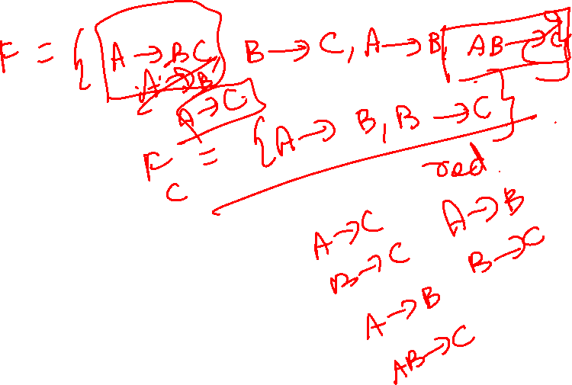

Slide 52

Example of Computing a Canonical Cover
R = (A, B, C) F = {A → BC B → C A → B AB → C}
Combine A → BC and A → B into A → BC
Set is now {A → BC, B → C, AB → C}
A is extraneous in AB → C
Check if the result of deleting A from AB → C is implied by the other dependencies
Yes: in fact, B → C is already present!
Set is now {A → BC, B → C}
C is extraneous in A → BC
Check if A → C is logically implied by A → B and the other dependencies
Yes: using transitivity on A → B and B → C.
Can use attribute closure of A in more complex cases
The canonical cover is: A → B B → C

Slide 53
Goals of Normalization
Decide whether a particular relation R is in “good” form.
In the case that a relation R is not in “good” form, decompose it into a set of relations {R₁, R₂, ..., R_{n}} such that
each relation is in good form
the decomposition is a lossless-join decomposition
Our theory is based on:
functional dependencies
multivalued dependencies

Slide 54

Decomposition
Decompose the relation schema Lending-schema into:
Branch-schema = (branch-name, branch-city,assets)
Loan-info-schema = (customer-name, loan-number, branch-name, amount)
All attributes of an original schema (R) must appear in the decomposition (R₁, R₂):
R = R₁ ∪ R₂
Lossless-join decomposition. For all possible relations r on schema R
r = ∏_{R1} (r) ∏_{R2} (r)
A decomposition of R into R₁ and R₂ is lossless join if and only if at least one of the following dependencies is in F⁺:
R₁ ∩ R₂ → R₁
R₁ ∩ R₂ → R₂

Slide 55
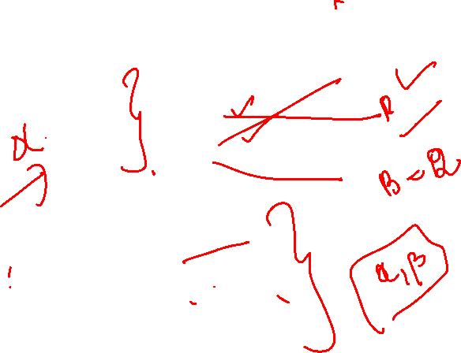
Example of Lossy-Join Decomposition
Lossy-join decompositions result in information loss.
Example: Decomposition of R = (A, B) R₁ = (A) R₂ = (B)
A
B
A
B
α
α
β
1
2
1
α
β
1
2
∏_{A}(r)
∏_{B(r)}
r
∏_{A} (r) ∏_{B} (r)
A
B
α
α
β
β
1
2
1
2

Slide 56
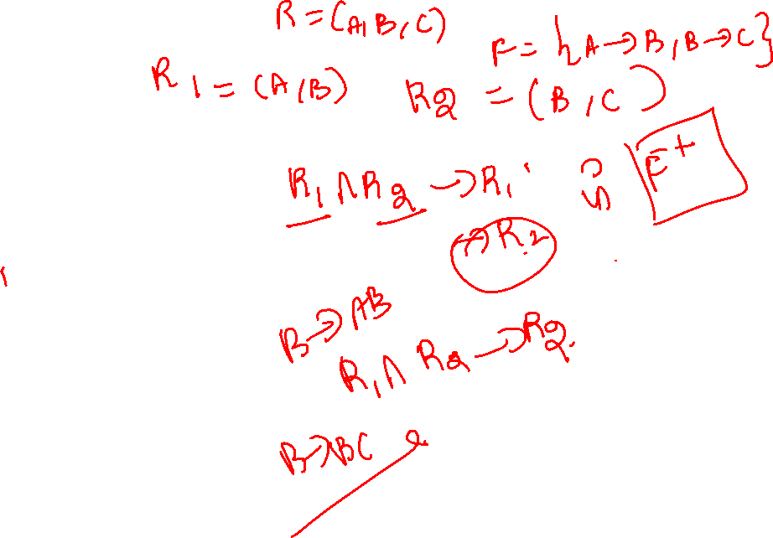

Slide 57
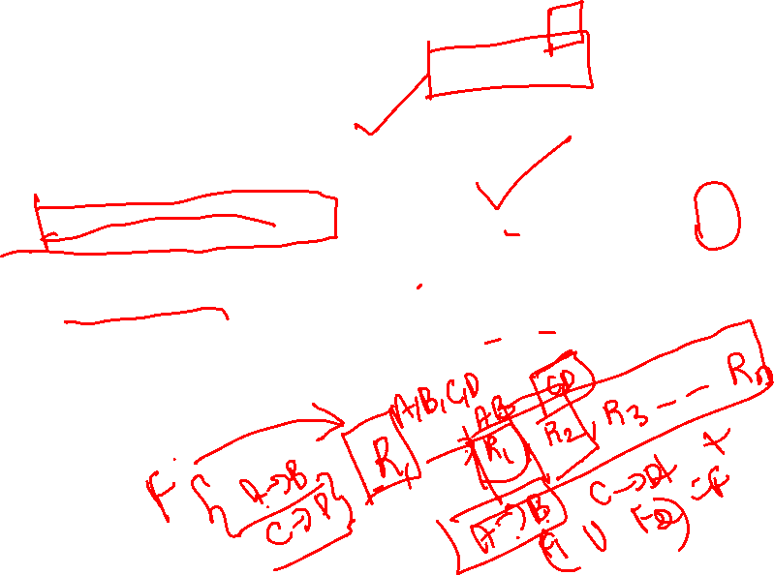
Normalization Using Functional Dependencies
When we decompose a relation schema R with a set of functional dependencies F into R₁, R₂,.., R_{n} we want
Lossless-join decomposition: Otherwise decomposition would result in information loss.
No redundancy: The relations R_{i} preferably should be in either Boyce-Codd Normal Form or Third Normal Form.
Dependency preservation: Let F_{i} be the set of dependencies F⁺ that include only attributes in R_{i}.
Preferably the decomposition should be dependency preserving, that is, (F₁ ∪ F₂ ∪ … ∪ F_{n})⁺ = F⁺
Otherwise, checking updates for violation of functional dependencies may require computing joins, which is expensive.

Slide 58
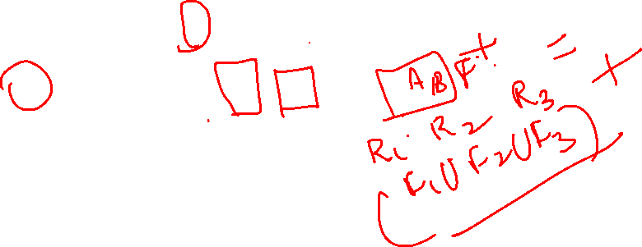
Testing for Dependency Preservation
To check if a dependency α→β is preserved in a decomposition of R into R₁, R₂, …, R_{n} Compute F⁺
for each schema Ri in R do
Begin
Fi=the restriction of F+ to Ri
End
F’=null
For each restriction Fi do
Begin
F’=F’UFi
End
Compute F’+
If(F’+=F+) then return (true) else return (false)
This procedure takes exponential time required to compute F⁺ and (F₁ ∪ F₂ ∪ … ∪ F_{n})⁺

Slide 59

Testing for Dependency Preservation
To check if a dependency α→β is preserved in a decomposition of R into R₁, R₂, …, R_{n} we apply the following simplified test (with attribute closure done w.r.t. F)
result = α while (changes to result) do for each R_{i} in the decomposition t = (result ∩ R_{i})⁺ ∩ R_{i} result = result ∪ t
If result contains all attributes in β, then the functional dependency α → β is preserved.
We apply the test on all dependencies in F to check if a decomposition is dependency preserving
This procedure takes polynomial time, instead of the exponential time required to compute F⁺ and (F₁ ∪ F₂ ∪ … ∪ F_{n})⁺

Slide 60
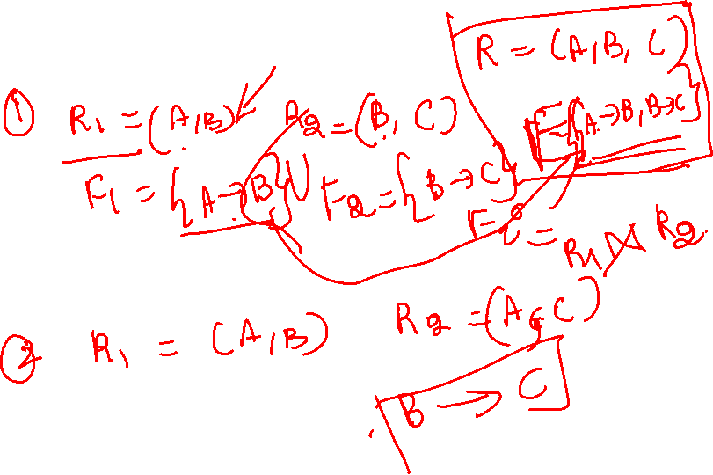
Example
R = (A, B, C) F = {A → B, B → C)
Can be decomposed in two different ways
R₁ = (A, B), R₂ = (B, C)
Lossless-join decomposition:
R₁ ∩ R₂ = {B} and B → BC
Dependency preserving
R₁ = (A, B), R₂ = (A, C)
Lossless-join decomposition:
R₁ ∩ R₂ = {A} and A → AB
Not dependency preserving (cannot check B → C without computing R₁ R₂)

Slide 61
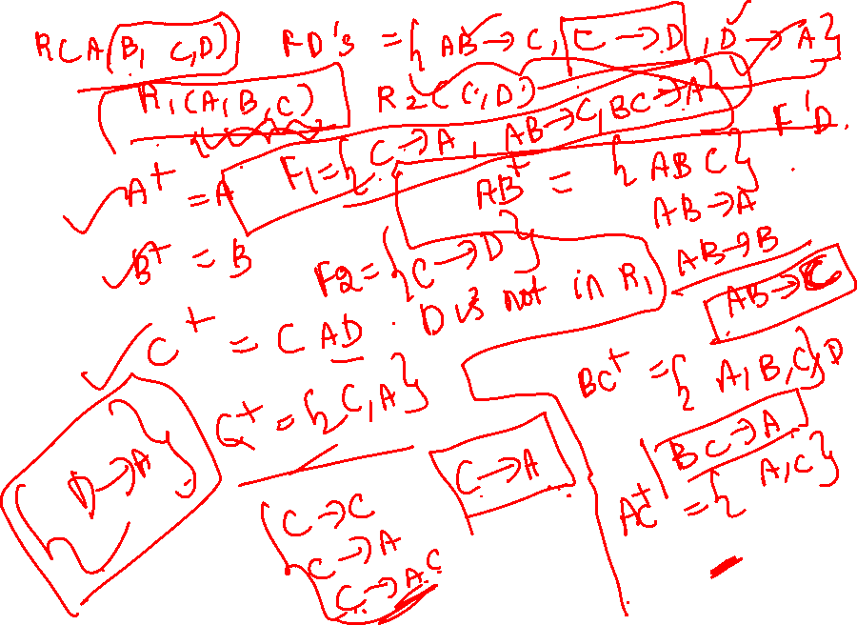

Slide 62
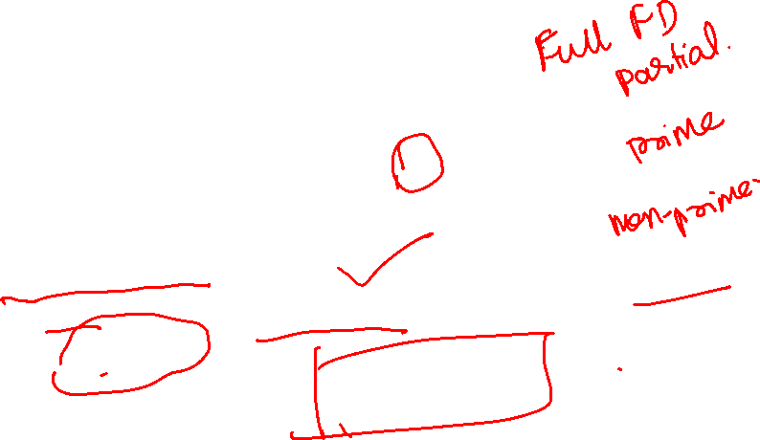
Second Normal Form (1)
Uses the concepts of FDs, primary key
Definitions
Prime attribute: An attribute that is member of the primary key K
Full functional dependency: a FD Y -> Z where removal of any attribute from Y means the FD does not hold any more
Examples:
{SSN, PNUMBER} -> HOURS is a full FD since neither SSN -> HOURS nor PNUMBER -> HOURS hold
{SSN, PNUMBER} -> ENAME is not a full FD (it is called a partial dependency ) since SSN -> ENAME also holds

Slide 63
Second Normal Form (2)
A relation schema R is in second normal form (2NF) if
It is in 1NF
every non-prime attribute A in R is fully functionally dependent on the primary key
R can be decomposed into 2NF relations via the process of 2NF normalization

Slide 64
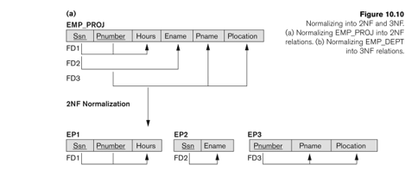
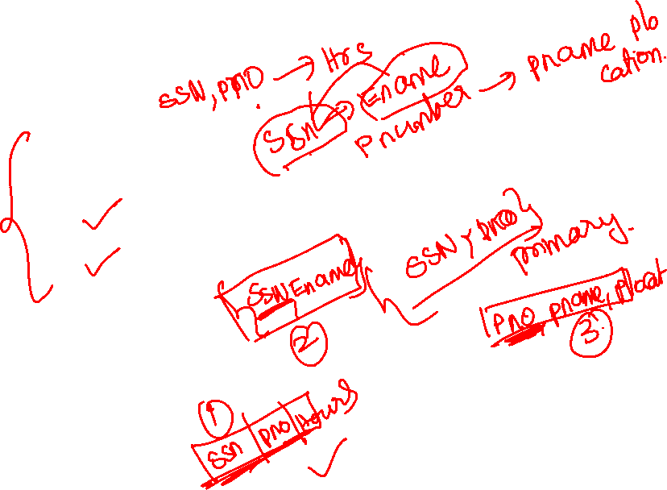
Second Normal Form (3)

Slide 65
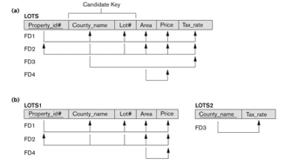

Second Normal Form (4)

Slide 66

Boyce-Codd Normal Form
A relation schema R is in BCNF with respect to a set F of functional
dependencies if for all functional dependencies in F⁺ of the form
α→ β, where α ⊆ R and β ⊆ R, at least one of the following holds:
α→ β is trivial (i.e., β ⊆ α)
α is a superkey for R

Slide 67
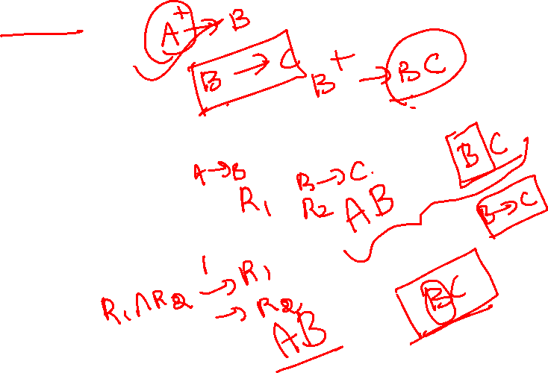
Example
R = (A, B, C) F = {A → B B → C} Key = {A}
R is not in BCNF
Decomposition R₁ = (A, B), R₂ = (B, C)
R₁ and R₂ in BCNF
Lossless-join decomposition
Dependency preserving

Slide 68
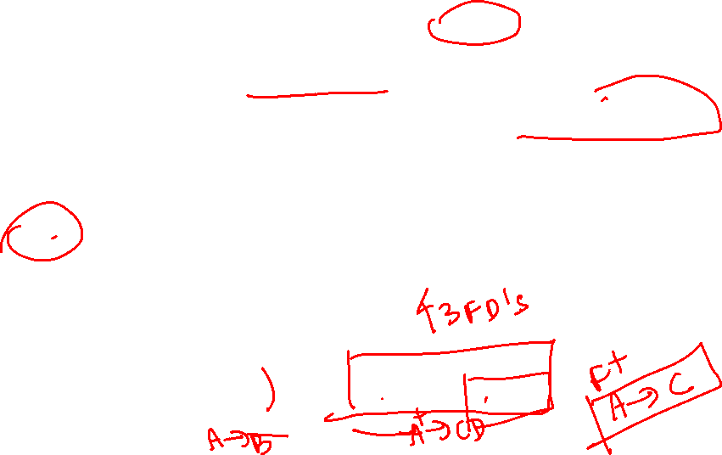
Testing for BCNF
To check if a non-trivial dependency α→β causes a violation of BCNF
1. compute α⁺ (the attribute closure of α), and
2. verify that it includes all attributes of R, that is, it is a superkey of R.
Simplified test: To check if a relation schema R is in BCNF, it suffices to check only the dependencies in the given set F for violation of BCNF, rather than checking all dependencies in F⁺.
If none of the dependencies in F causes a violation of BCNF, then none of the dependencies in F⁺ will cause a violation of BCNF either.
However, using only F is incorrect when testing a relation in a decomposition of R
E.g. Consider R (A, B, C, D), with F = { A →B, B →C}
Decompose R into R₁(A,B) and R₂(A,C,D)
Neither of the dependencies in F contain only attributes from (A,C,D) so we might be mislead into thinking R₂ satisfies BCNF.
In fact, dependency A → C in F⁺ shows R₂ is not in BCNF.

Slide 69
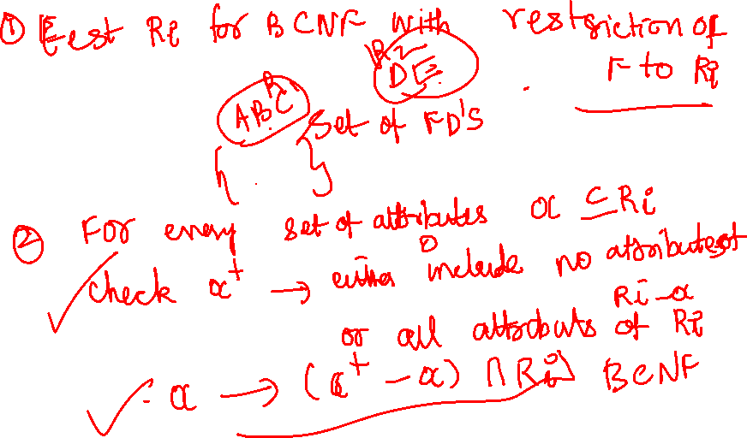
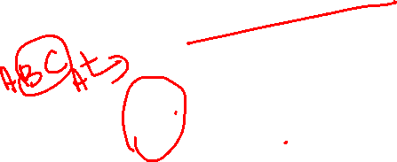

Slide 70
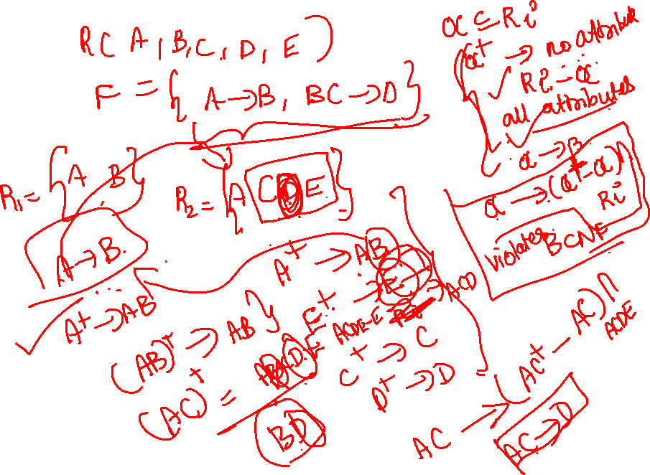

Slide 71
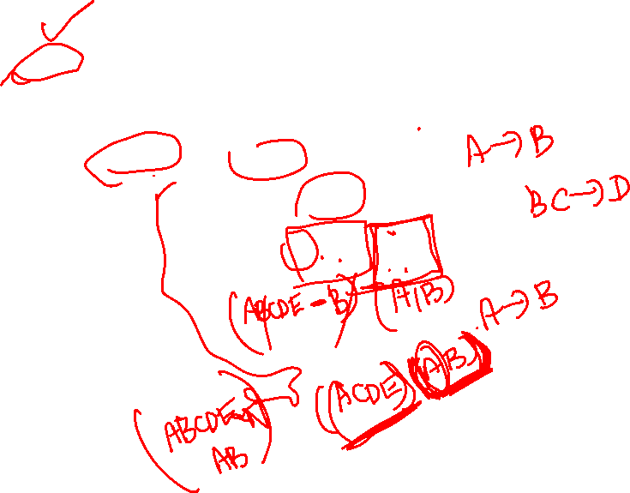
BCNF Decomposition Algorithm
result := {R}; done := false; compute F⁺; while (not done) do if (there is a schema R_{i} in result that is not in BCNF) then begin let α  → β be a nontrivial functional dependency that holds on R_{i} such that α  → R_{i} is not in F⁺, and α ∩ β = ∅; result := (result – R_{i} ) ∪ (R_{i} – β) ∪ (α, β ); end else done := true;
Note: each R_{i} is in BCNF, and decomposition is lossless-join.

Slide 72
BCNF Decomposition Algorithm
Initialize S = {R}
While S has a relation R' that is not in BCNF do:
Pick a FD: X->Y that holds in R' and violates BCNF
Add the relation XY to S
Update R' = R'-Y
Return S

Slide 73
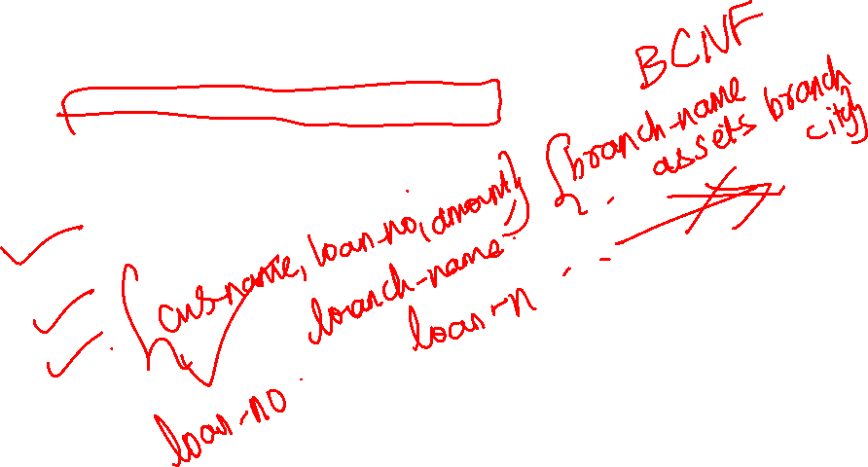
Example of BCNF Decomposition
R = (branch-name, branch-city, assets,
customer-name, loan-number, amount)
F = {branch-name → assets branch-city
loan-number → amount branch-name}
Key = {loan-number, customer-name}
Decomposition
R₁ = (branch-name, branch-city, assets)
R₂ = (branch-name, customer-name, loan-number, amount)
R₃ = (branch-name, loan-number, amount)
R₄ = (customer-name, loan-number)
Final decomposition R₁, R₃, R₄

Slide 74
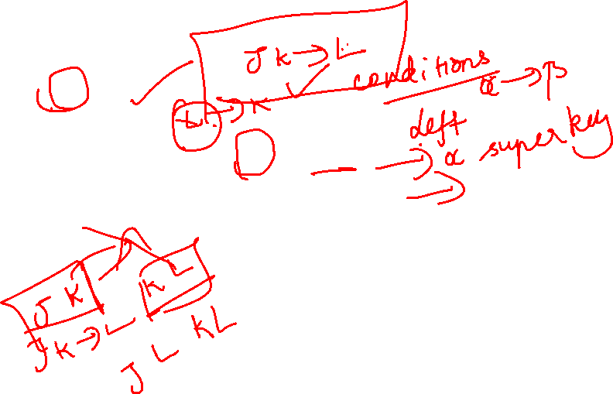
BCNF and Dependency Preservation
It is not always possible to get a BCNF decomposition that is
dependency preserving
R = (J, K, L) F = {JK → L L → K} Two candidate keys = JK and JL
R is not in BCNF
Any decomposition of R will fail to preserve
JK → L

Slide 75
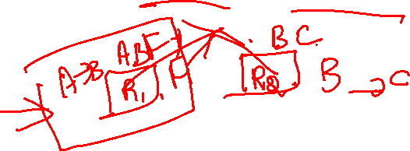
Third Normal Form: Motivation
There are some situations where
BCNF is not dependency preserving, and
efficient checking for FD violation on updates is important
Solution: define a weaker normal form, called Third Normal Form.
Allows some redundancy (with resultant problems; we will see examples later)
But FDs can be checked on individual relations without computing a join.
There is always a lossless-join, dependency-preserving decomposition into 3NF.

Slide 76

Third Normal Form
A relation schema R is in third normal form (3NF) if for all:
α → β in F⁺ at least one of the following holds:
α → β is trivial (i.e., β ∈ α)
α is a superkey for R
Each attribute A in β – α is contained in a candidate key for R.
(NOTE: each attribute may be in a different candidate key)
If a relation is in BCNF it is in 3NF (since in BCNF one of the first two conditions above must hold).
Third condition is a minimal relaxation of BCNF to ensure dependency preservation.

Slide 77

3NF (Cont.)
Example
R = (J, K, L) F = {JK → L, L → K}
Two candidate keys: JK and JL
R is in 3NF
JK → L JK is a superkey L → K K is contained in a candidate key
BCNF decomposition has (JL) and (LK)
Testing for JK → L requires a join
There is some redundancy in this schema

Slide 78

Third Normal Form
A relation schema R is in third normal form (3NF) if it is in 2NF and no non-prime attribute A in R is transitively dependent on the primary key
R can be decomposed into 3NF relations via the process of 3NF normalization
NOTE:
In X -> Y and Y -> Z, with X as the primary key, we consider this a problem only if Y is not a candidate key.
When Y is a candidate key, there is no problem with the transitive dependency .
E.g., Consider EMP (SSN, Emp#, Salary ).
Here, SSN -> Emp# -> Salary and Emp# is a candidate key.

Slide 79
Third Normal Form (2)
Definition:
Transitive functional dependency: a FD X -> Z that can be derived from two FDs X -> Y and Y -> Z
Examples:
SSN -> DMGRSSN is a transitive FD
Since SSN -> DNUMBER and DNUMBER -> DMGRSSN hold
SSN -> ENAME is non-transitive
Since there is no set of attributes X where SSN -> X and X -> ENAME

Slide 80
Testing for 3NF
Optimization: Need to check only FDs in F, need not check all FDs in F⁺.
Use attribute closure to check for each dependency α → β, if α is a superkey.
If α is not a superkey, we have to verify if each attribute in β is contained in a candidate key of R
this test is rather more expensive, since it involve finding candidate keys
testing for 3NF has been shown to be NP-hard
Interestingly, decomposition into third normal form (described shortly) can be done in polynomial time

Slide 81

3NF Decomposition Algorithm
Let F_{c} be a canonical cover for F; i := 0; for each functional dependency α → β in F_{c} do if none of the schemas R_{j}, 1 ≤ j ≤ i contains α β then begin i := i + 1; R_{i} := α β end if none of the schemas R_{j}, 1 ≤ j ≤ i contains a candidate key for R then begin i := i + 1; R_{i} := any candidate key for R; end return (R₁, R₂, ..., R_{i})

Slide 82
3NF Decomposition Algorithm (Cont.)
Above algorithm ensures:
each relation schema R_{i} is in 3NF
decomposition is dependency preserving and lossless-join

Slide 83

Example
Relation schema:
Banker-info-schema = (branch-name, customer-name, banker-name, office-number)
The functional dependencies for this relation schema are: banker-name → branch-name office-number customer-name branch-name → banker-name
The key is:
{customer-name, branch-name}

Slide 84

Applying 3NF to Banker-info-schema
The for loop in the algorithm causes us to include the following schemas in our decomposition:
Banker-office-schema = (banker-name, branch-name, office-number) Banker-schema = (customer-name, branch-name, banker-name)
Since Banker-schema contains a candidate key for Banker-info-schema, we are done with the decomposition process.

Slide 85


Third Normal Form (4)

Slide 86


Third Normal Form (3)

Slide 87
Comparison of BCNF and 3NF
It is always possible to decompose a relation into relations in 3NF and
the decomposition is lossless
the dependencies are preserved
It is always possible to decompose a relation into relations in BCNF and
the decomposition is lossless
it may not be possible to preserve dependencies.

Slide 88

Comparison of BCNF and 3NF (Cont.)
Example of problems due to redundancy in 3NF
R = (J, K, L) F = {JK → L, L → K}
J
L
K
j₁
j₂
j₃
null
l₁
l₁
l₁
l₂
k₁
k₁
k₁
k₂
A schema that is in 3NF but not in BCNF has the problems of
repetition of information (e.g., the relationship l₁, k₁)
need to use null values (e.g., to represent the relationship l₂, k₂ where there is no corresponding value for J).

Slide 89
Design Goals
Goal for a relational database design is:
BCNF.
Lossless join.
Dependency preservation.
If we cannot achieve this, we accept one of
Lack of dependency preservation
Redundancy due to use of 3NF
Interestingly, SQL does not provide a direct way of specifying functional dependencies other than superkeys.
Can specify FDs using assertions, but they are expensive to test
Even if we had a dependency preserving decomposition, using SQL we would not be able to efficiently test a functional dependency whose left hand side is not a key.

Slide 90
Normal Forms Defined Informally
1st normal form
All attributes depend on the key
2nd normal form
All attributes depend on the whole key
3rd normal form
All attributes depend on nothing but the key

Slide 91


Slide 92


Slide 93
Multivalued Dependencies
There are database schemas in BCNF that do not seem to be sufficiently normalized
Consider a database
classes(course, teacher, book)
such that (c,t,b) ∈ classes means that t is qualified to teach c, and b is a required textbook for c
The database is supposed to list for each course the set of teachers any one of which can be the course’s instructor, and the set of books, all of which are required for the course (no matter who teaches it).

Slide 94
Multivalued Dependencies (Cont.)
course
teacher
book
Database
operating systems
{Avi, Hank,
Sudarshan}
{Avi, Jim}
{DB Concepts
Ullman}
{OS Concepts,
Shaw}
classes
There are no non-trivial functional dependencies and therefore the relation is in BCNF
Insertion anomalies – i.e., if Sara is a new teacher that can teach database, two tuples need to be inserted
(database, Sara, DB Concepts) (database, Sara, Ullman)

Slide 95
Multivalued Dependencies (Cont.)
course
teacher
book
t1
t2
t3
t4
database
database
database
database
database
database
operating systems
operating systems
operating systems
operating systems
Avi
Hank
Hank
Avi
Sudarshan
Sudarshan
Avi
Avi
Jim
Jim
DB Concepts
Ullman
DB Concepts
Ullman
DB Concepts
Ullman
OS Concepts
Shaw
OS Concepts
Shaw
classes
There are no non-trivial functional dependencies and therefore the relation is in BCNF
Insertion anomalies – i.e., if Sara is a new teacher that can teach database, two tuples need to be inserted
(database, Sara, DB Concepts) (database, Sara, Ullman)

Slide 96
Multivalued Dependencies (MVDs)
Let R be a relation schema and let α ⊆ R and β ⊆ R. The multivalued dependency
α →→ β
holds on R if in any legal relation r(R), for all pairs for tuples t₁ and t₂ in r such that t₁[α] = t₂ [α], there exist tuples t₃ and t₄ in r such that:
t₁[α] = t₂ [α] = t₃ [α] = t₄ [α] t₃[β] = t₁ [β] t₃[R – β] = t₂[R – β] t₄ [β] = t₂[β] t₄[R – β] = t₁[R – β]

Slide 97
Multivalued Dependencies (Cont.)
Therefore, it is better to decompose classes into:
course
teacher
database
database
database
operating systems
operating systems
Avi
Hank
Sudarshan
Avi
Jim
teaches
course
book
database
database
operating systems
operating systems
DB Concepts
Ullman
OS Concepts
Shaw
text
We shall see that these two relations are in Fourth Normal Form (4NF)

Slide 98
Example (Cont.)
In our example:
course →→ teacher course →→ book
The above formal definition is supposed to formalize the notion that given a particular value of Y (course) it has associated with it a set of values of Z (teacher) and a set of values of W (book), and these two sets are in some sense independent of each other.

Slide 99
Use of Multivalued Dependencies
We use multivalued dependencies in two ways:
1. To test relations to determine whether they are legal under a given set of functional and multivalued dependencies
2. To specify constraints on the set of legal relations. We shall thus concern ourselves only with relations that satisfy a given set of functional and multivalued dependencies.
If a relation r fails to satisfy a given multivalued dependency, we can construct a relations r′ that does satisfy the multivalued dependency by adding tuples to r.

Slide 100
Fourth Normal Form
A relation schema R is in 4NF with respect to a set D of functional and multivalued dependencies if for all multivalued dependencies in D⁺ of the form α →→ β, where α ⊆ R and β ⊆ R, at least one of the following hold:
α →→ β is trivial (i.e., β ⊆ α or α ∪ β = R)
α is a superkey for schema R
If a relation is in 4NF it is in BCNF

Slide 101
Restriction of Multivalued Dependencies
The restriction of D to R_{i} is the set D_{i} consisting of
All functional dependencies in D⁺ that include only attributes of R_{i}
All multivalued dependencies of the form
α →→ (β ∩ R_{i})
where α ⊆ R_{i} and α →→ β is in D⁺

Slide 102
4NF Decomposition Algorithm
result: = {R}; done := false; compute D⁺; Let D_{i} denote the restriction of D⁺ to R_{i}
while (not done) if (there is a schema R_{i} in result that is not in 4NF) then begin
let α →→ β be a nontrivial multivalued dependency that holds on R_{i} such that α → R_{i} is not in D_{i}, and α∩β=φ; result := (result - R_{i}) ∪ (R_{i} - β) ∪ (α, β); end else done:= true;
Note: each R_{i} is in 4NF, and decomposition is lossless-join

Slide 103
Further Normal Forms
Join dependencies generalize multivalued dependencies
lead to project-join normal form (PJNF) (also called fifth normal form)
A class of even more general constraints, leads to a normal form called domain-key normal form.
Problem with these generalized constraints: are hard to reason with, and no set of sound and complete set of inference rules exists.
Hence rarely used

Slide 104

Thank You!!!

